Slide 1

Final Project Laptop Prices Analysis
MATH 587
Advanced Applied Regression
Group 1
Nada – Reda -AbdulRahman

Slide 2
Agenda
Data Dictionary
EDD and EDA
Outliers and Missing Values
Transforming and Omitting Variables
Creating Dummy Variables
Correlation Matrix and Removal of Highly Correlated Variables
Residual Analysis
Feature selection
Linear Regression & Prediction
Conclusion

Slide 3
Data Dictionary
Metadata for our dataset
Variable​ | Definition
brand | The name of the Laptop Brand
model | Model Name of the laptop
processor_brand | Name of processor producer
processor_name | Technical /commercial name of the processor
processor_gnrtn | The generation number of the processor
ram_ | RAM (Random Access Memory), the RAM capacity in GB
ram_type | The type of the RAM
ssd | The Capacity if the hard drive is SSD in GB
hdd | The Capacity if the hard drive is HDD in GB
os | Operation System
os_bit | The bit of operation system, 64-bit or 32-bit

Slide 4
Data Dictionary
Metadata for our dataset
Variable​ | Definition
graphic_card_ | External Graphic card capacity in GB
weight | The wight for the Laptop, as it have three segments ( ThinNlight, Casual , and Gaming)
display_size | The display size of the screen
warranty | Represent the number of years for active warranty
Touchscreen | Shows if the laptop has touchscreen or not ( 0 means no didn’t have, while 1 mean yes it has)
msoffice | Represent MC office apps if its available or not ( 0- not available, 1 – available)
latest_price_USD | The price of the laptop
star_rating | Rating result based on the customer feedback; the ration is from 0 to 5

Slide 5
Data Dictionary
Metadata for our dataset
Variable​ | Definition
ratings | Number of people that rate the laptop from 0-5 stars
reviews | Number of people who wrote feedback on the laptop

Slide 6
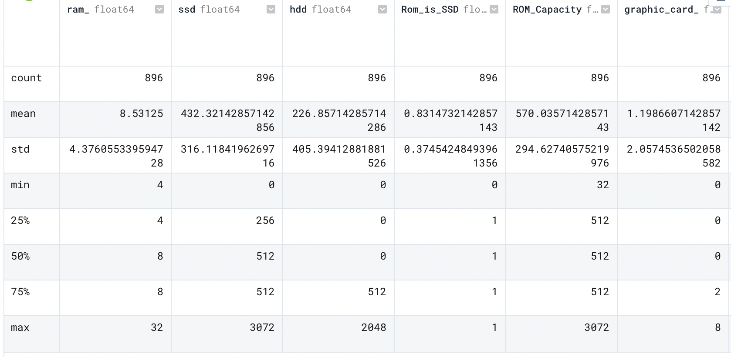
Extended Data Dictionary

Slide 7
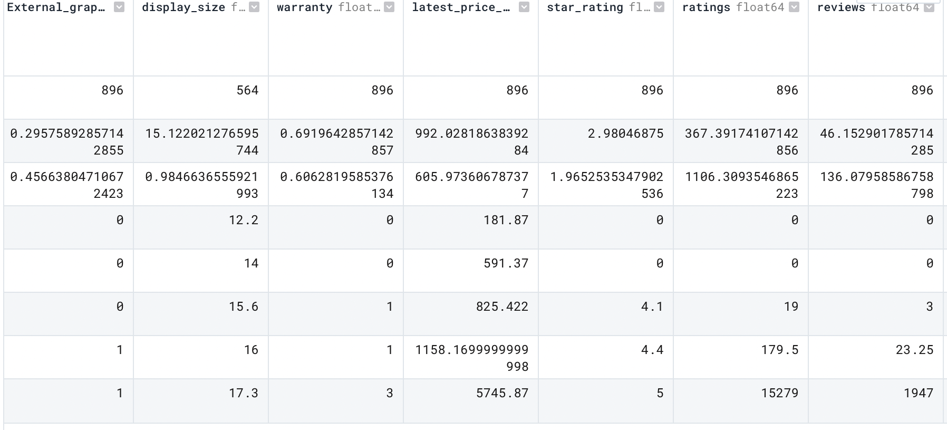
Extended Data Dictionary

Slide 8
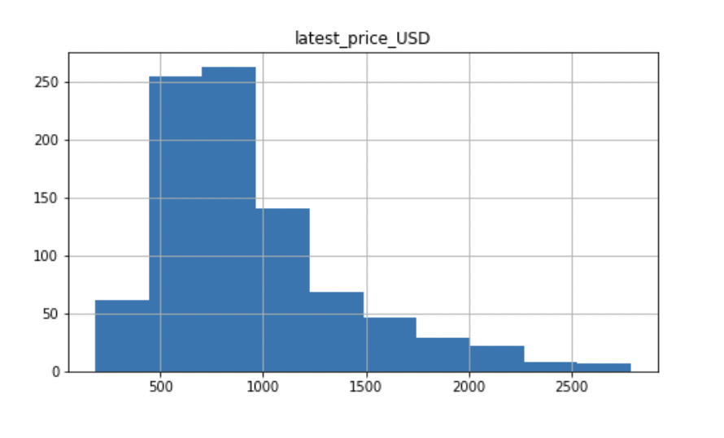
Exploratory Data Analysis
Target Variable

Slide 9
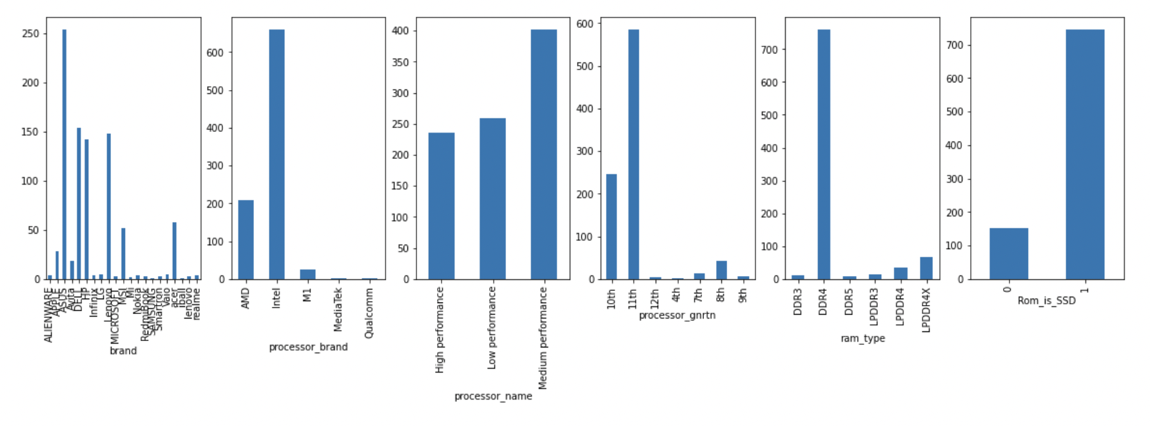
Exploratory Data Analysis
Categorical Variables

Slide 10
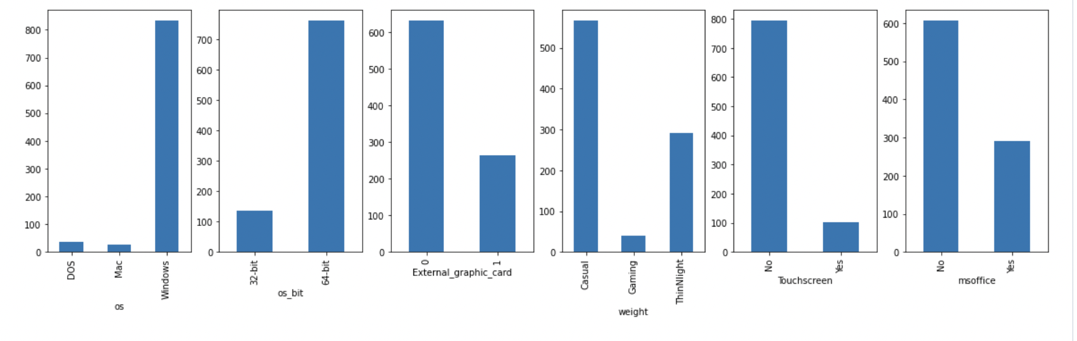
Exploratory Data Analysis
Categorical Variables (Con't)

Slide 11
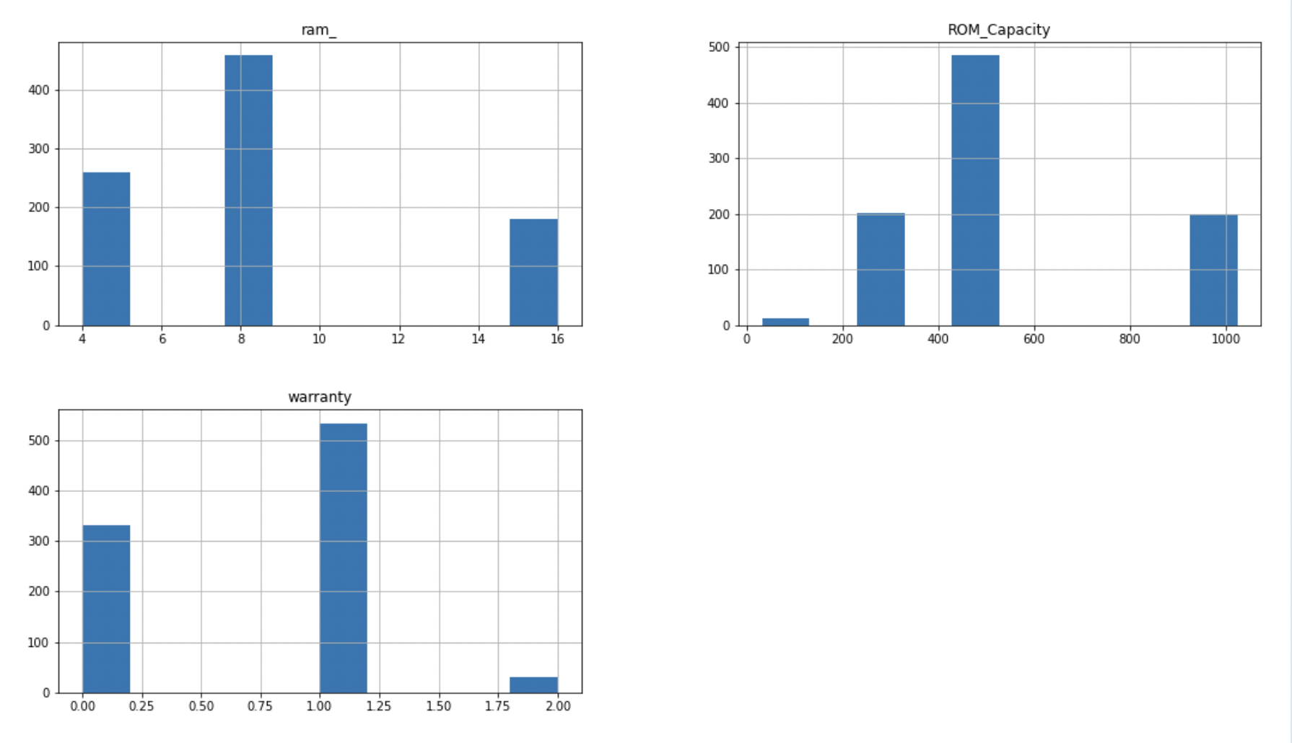
Exploratory Data Analysis
Continuous Variables

Slide 12
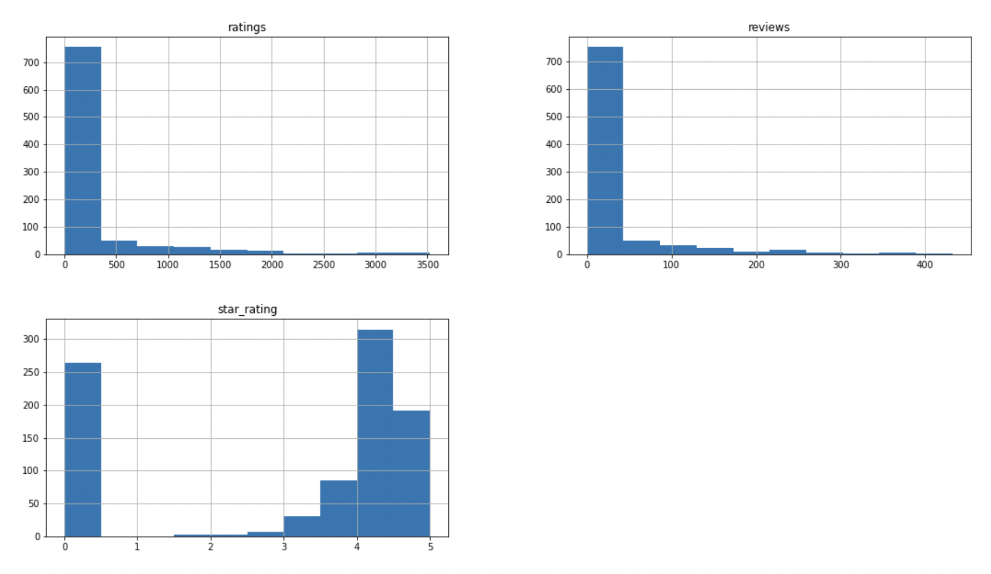
Exploratory Data Analysis
Continuous Variables (Con't)

Slide 13
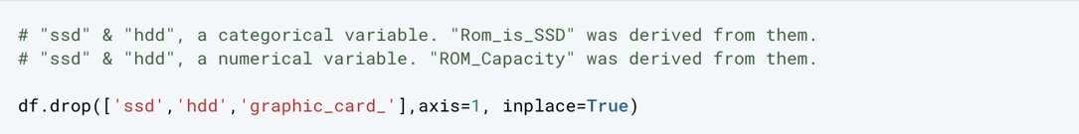
Transforming and Omitting Variables
Processor name variable includes many values. Therefore, it is transformed to be grouped as high, medium, and low performance.

Slide 14
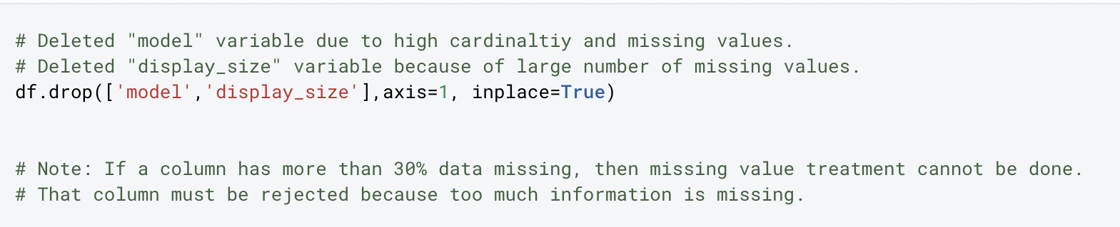
Missing Values Treatment

Slide 15
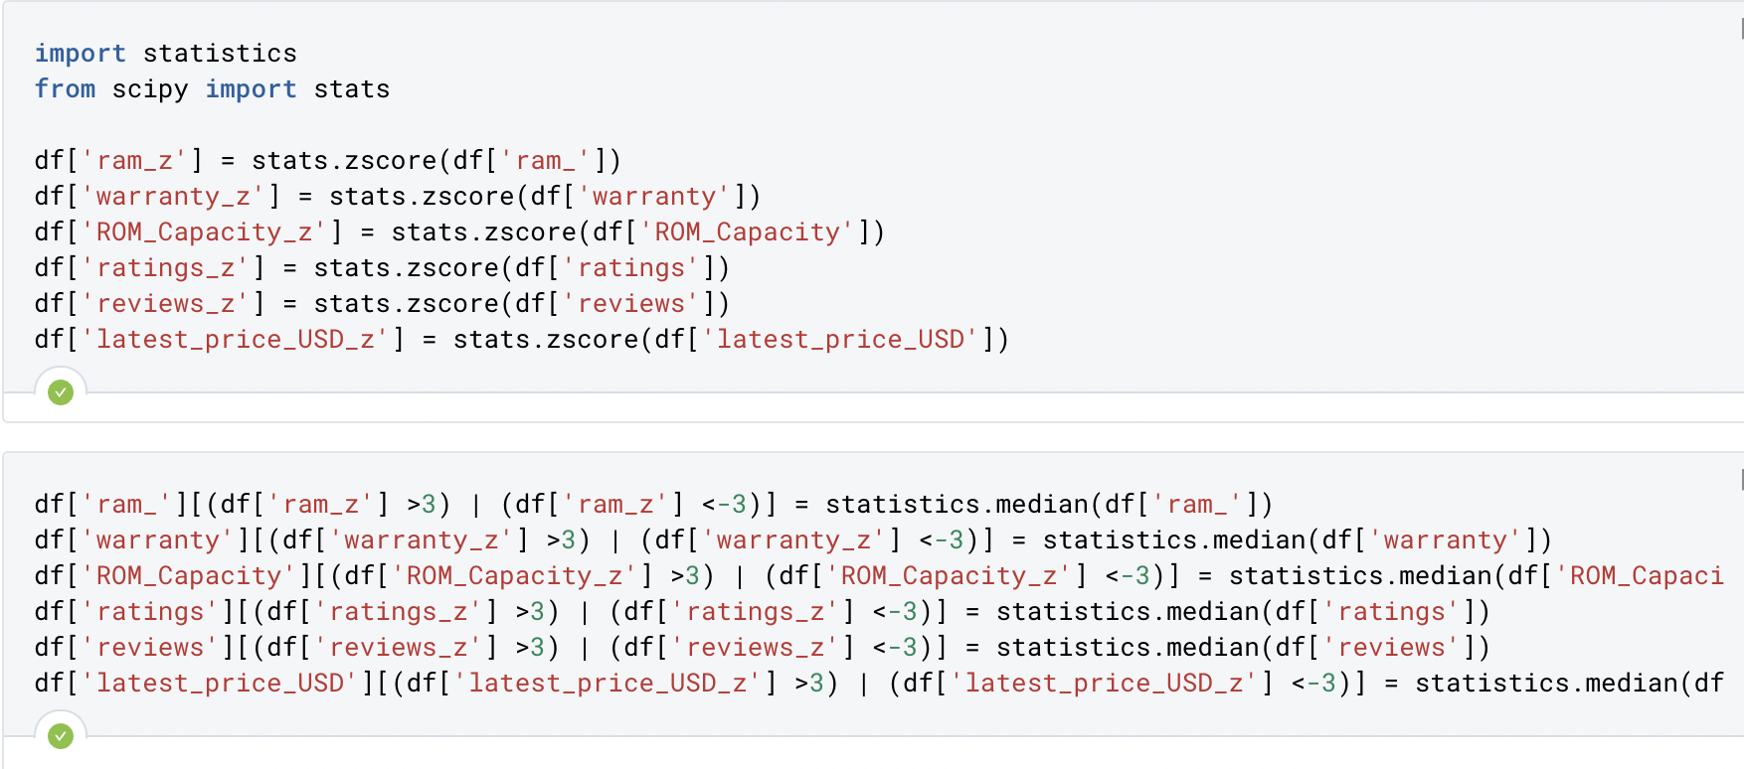
Outlier Treatment
Outliers were determined using z-value test and imputed using median (Skewed distribution)

Slide 16
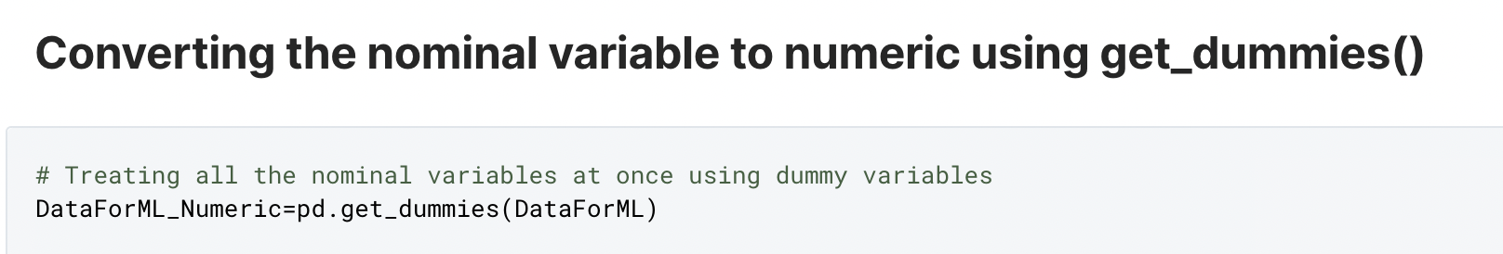
Dummy Variable

Slide 17
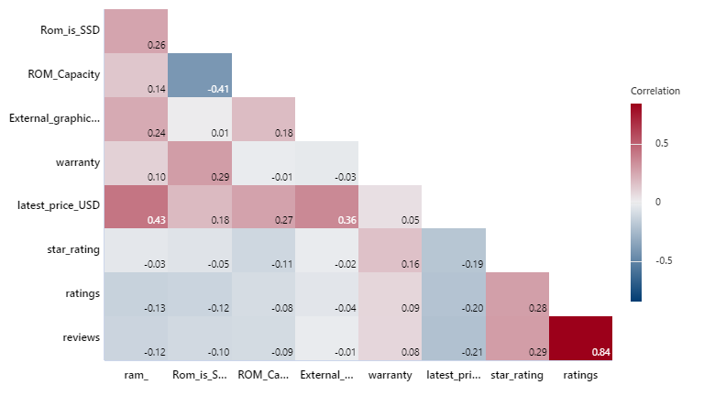
Correlation Matrix &Removal of Highly Correlated Variables
The reviews and ratings variables are highly correlated.
At this step, the rating variable was omitted.

Slide 18
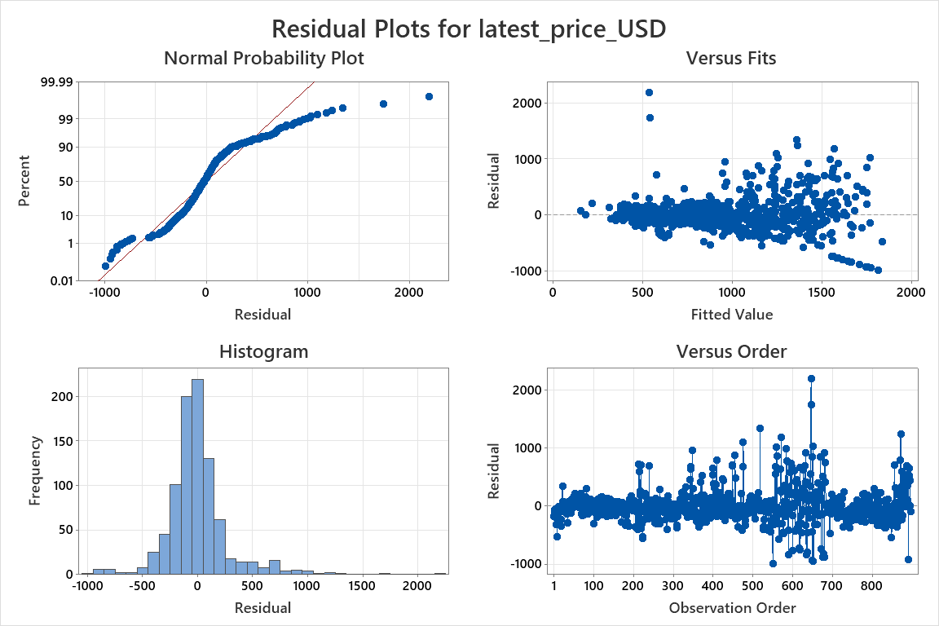
Residual Analysis
The Normal Probability Plot & Histogram
Shows that data distribution is almost normal but with some outliers.
Versus Fits
Shows some degree of heteroscedasticity.
Versus Order
Shows no pattern so the residuals are independent.

Slide 19
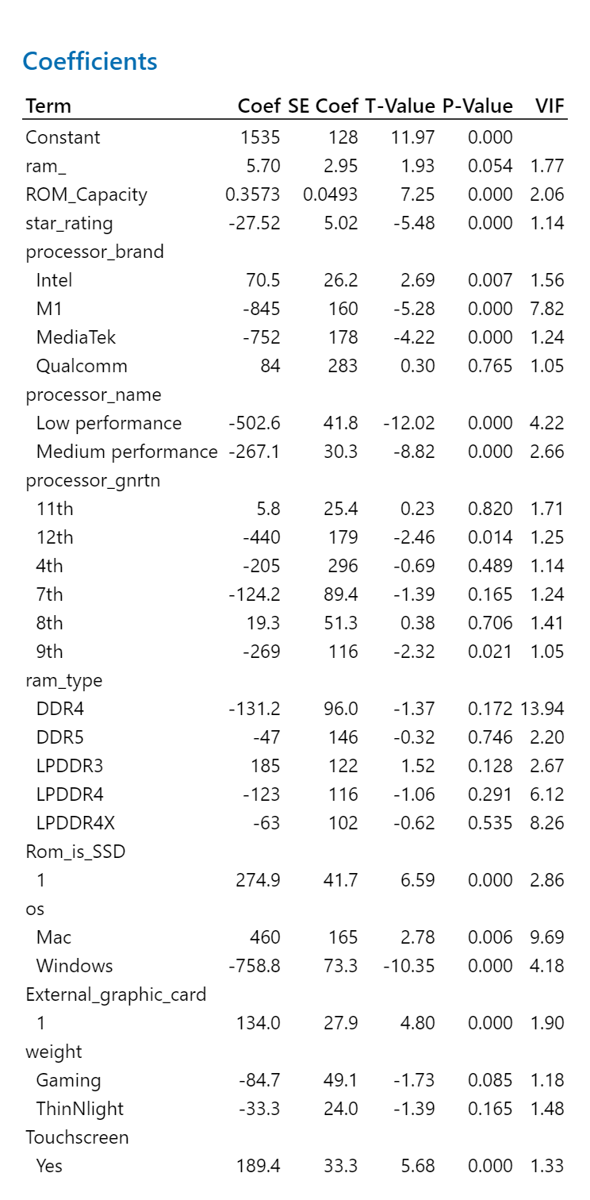
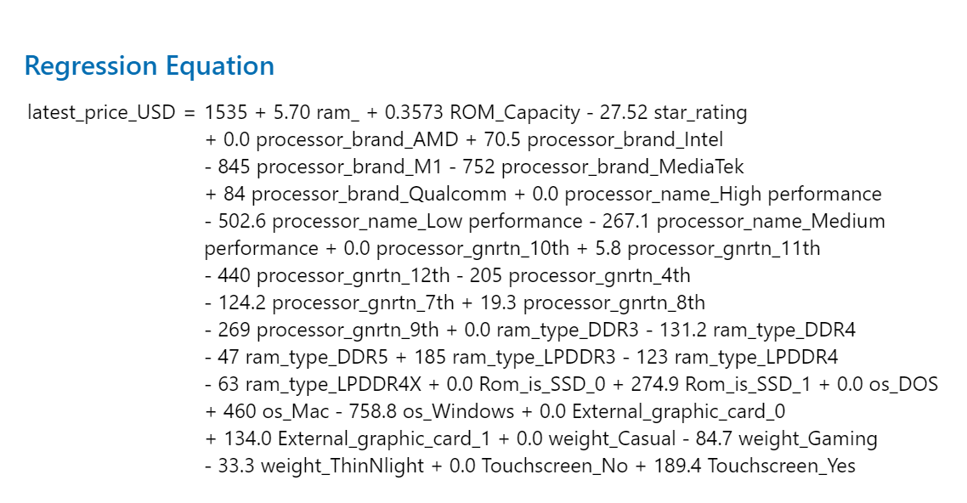
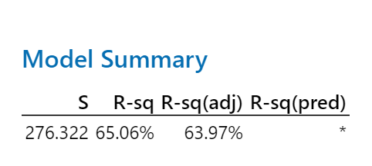
Feature selection - Stepwise

Slide 20
Feature selection – Forward Selection

Slide 21
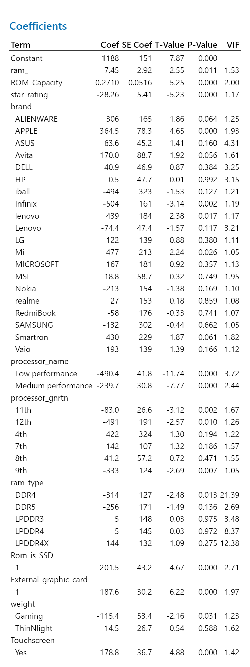
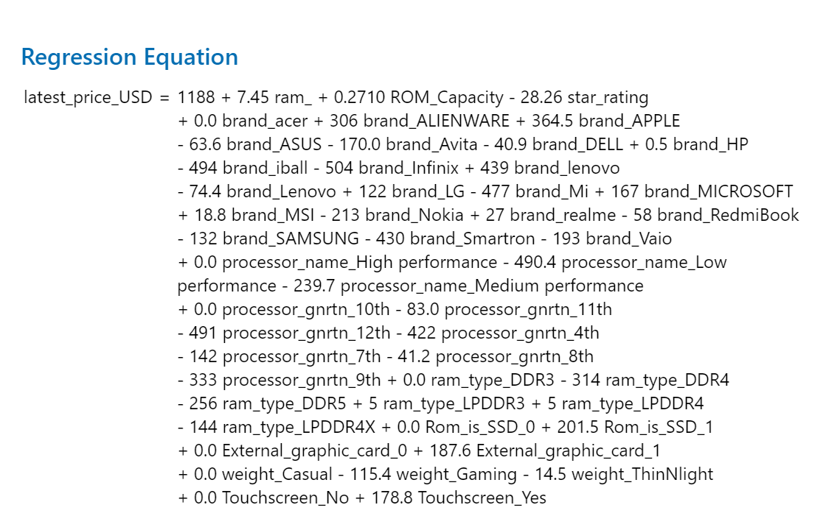
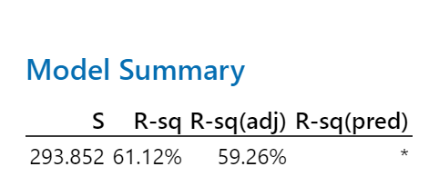
Feature selection – Backward Elimination

Slide 22
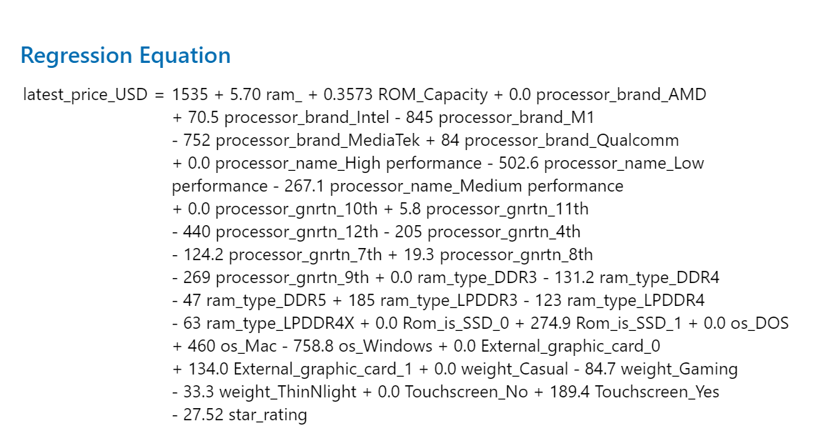
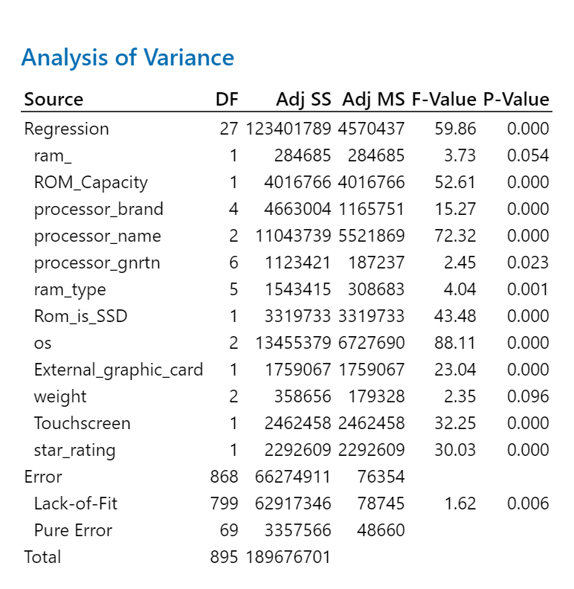
Linear Regression & Prediction
The selected variables are based on the stepwise selection method. Forward selection resulted in the same as stepwise.

Slide 23
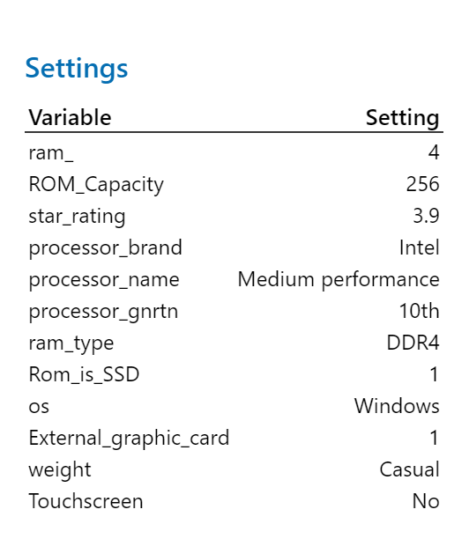
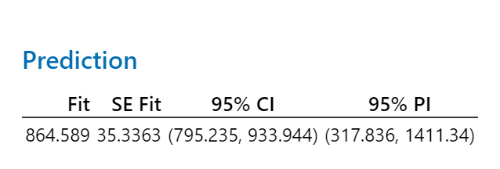
Linear Regression & Prediction
The selected variables are based on the stepwise selection method.
12 predictors
3 Numerical & 9 Categorical

Slide 24

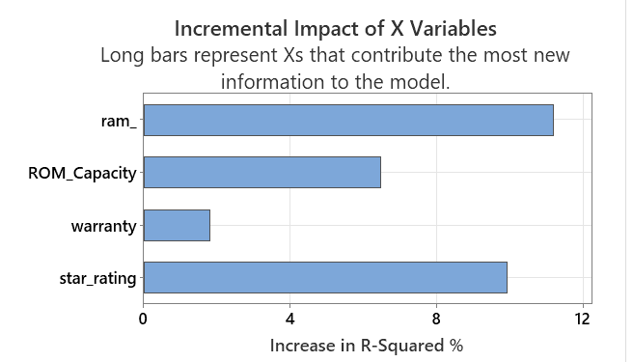
Conclusion
We have found that 12 Variable/s are made the high impact on the predicting Laptop price.
Dataset need to be expanded to have more records, to increase the accuracy for the model.

Slide 25

Thank You.
MATH 587
Advanced Applied Regression

